Slide 1



Supervised Learning - Regression

Slide 2



Trainer Bio
Experience :
Data Scientist at Jabar Digital Service
Data Science Tutor at Shift Academy
Business Intelligence Analyst at Jabar Digital Service
Owner and Consultant at Barz Data Consultant
Data Scientist at IYKRA
Data Analyst at BAPPEDA Sukoharjo
Data Analyst at PT. Arah Environmental
www.linkedin.com/in/akbar-maulana/
akbar.maulana2298@gmail.com

Slide 3
Analisis Regresi

Slide 4
Overview Regresi
Tujuan utama dari analisis regresi adalah untuk memprediksi output yang merupakan nilai numerik, dari data input yang diberikan. Metode regresi:
Regresi Linier Sederhana
Regresi Linear Berganda
Regresi lasso
Regresi Elastic Net
Regresi Ridge
dll

Slide 5
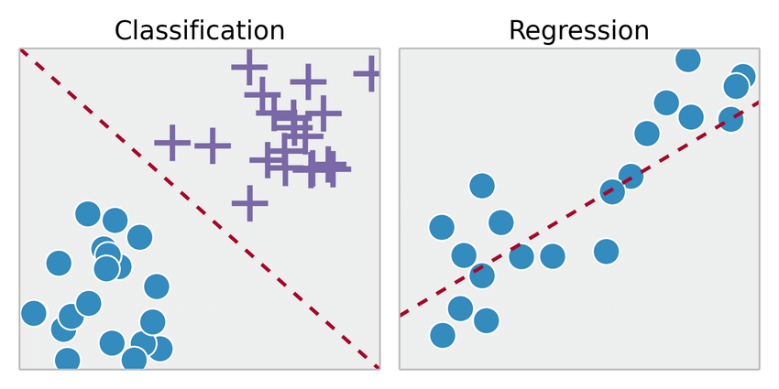
Input vs Output
Metode | Input | Output
Regresi | Kategorik, Numerik | Numerik
Klasifikasi | Kategorik, Numerik | Kategorik

Slide 6
Objectives
Prediction
Estimate Y(Output) at value of X(Input)
Causal Inference
Find variables X that have strong relationship with Y

Slide 7
Regresi Linier

Slide 8
Regresi Linier
Regresi linier adalah pendekatan linier untuk memodelkan hubungan antara variabel dependen(akibat) dan satu atau lebih variabel variabel independen(sebab).
Input Output
Jenis Regres Linier :
Regresi Linier Sederhana
Regresi Linear Berganda
Sebab
(Variabel Independen)
Akibat
(Variabael Dependen)

Slide 9
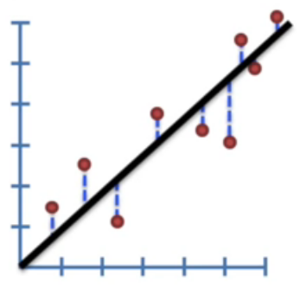
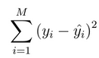
Main Idea
Used least-squares to fit a line to the data (Only numerical / continues data)
How?
Find the minimum of
for every line combination

Slide 10
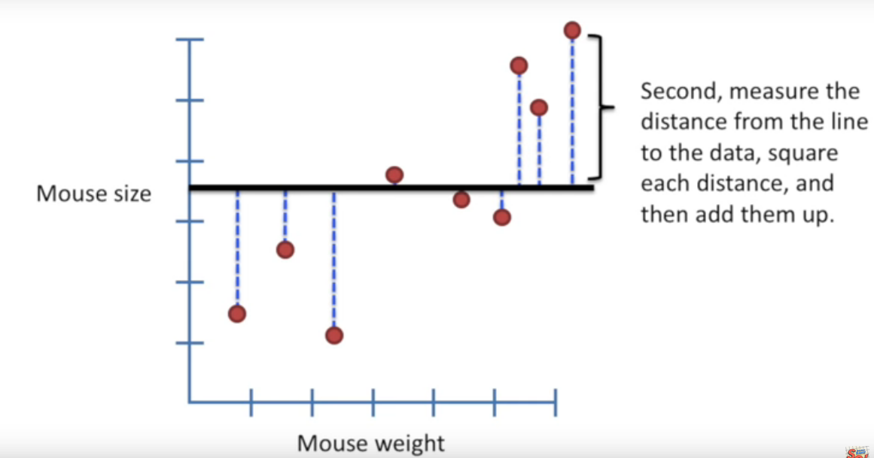
Goal: Fitting a line to the data

Slide 11
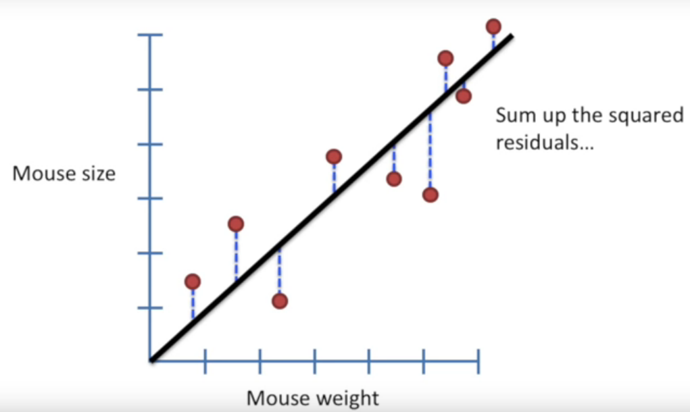
Rotate the line again...

Slide 12
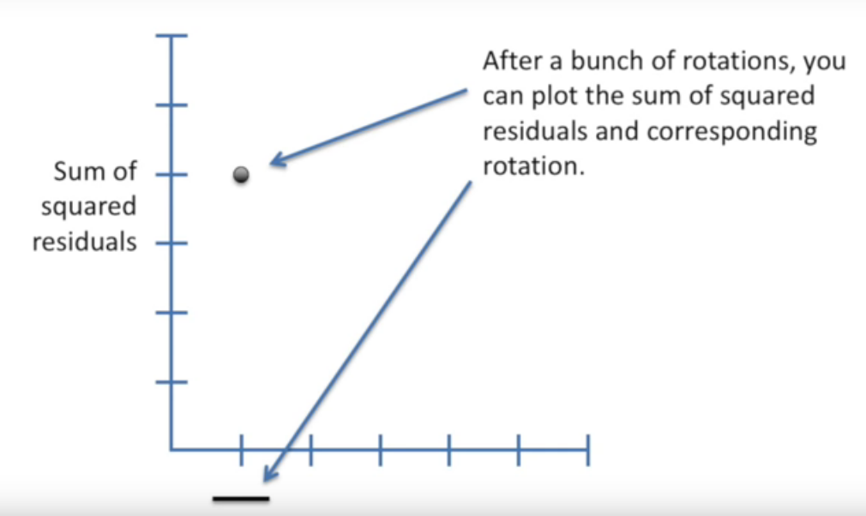

Slide 13
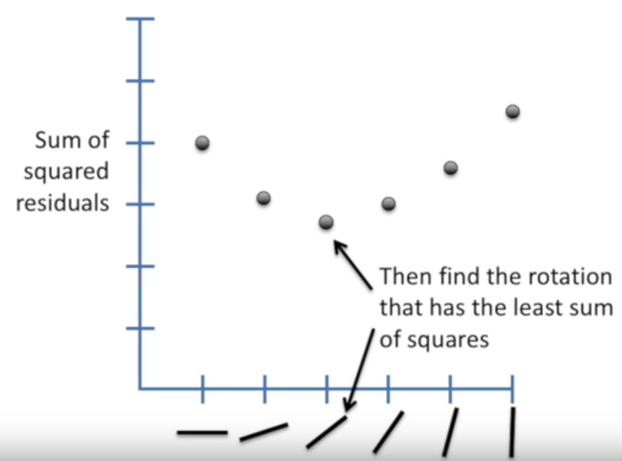

Slide 14
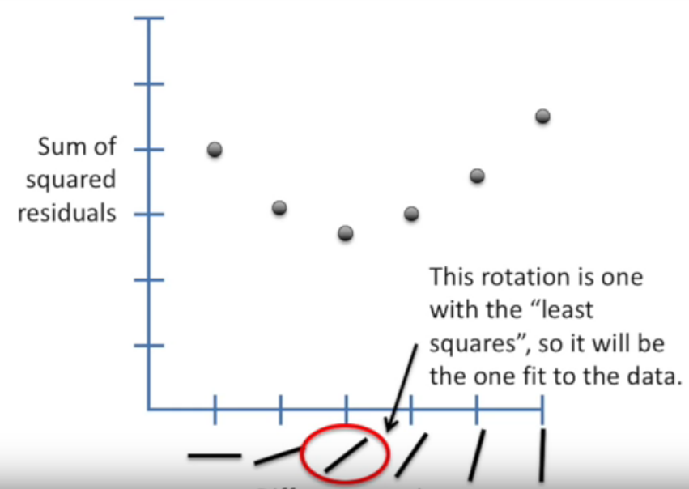

Slide 15
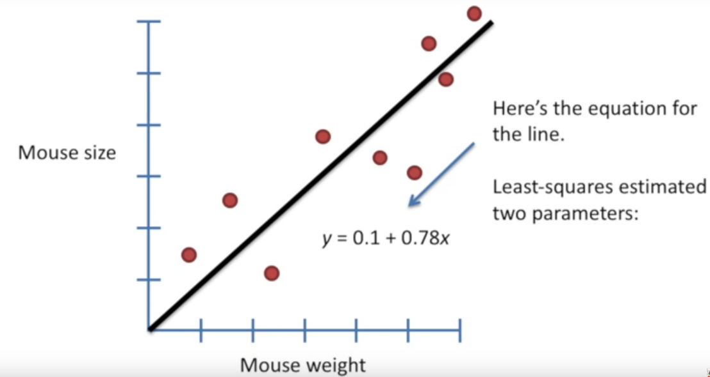

Slide 16
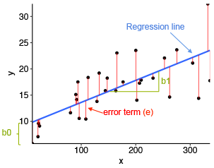
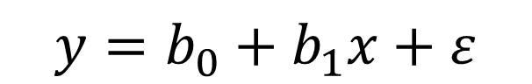
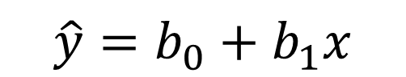
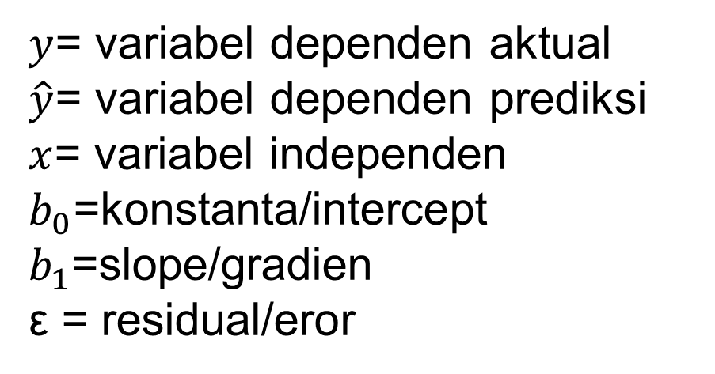
Regresi Linier Sederhana
Regresi linier sederhana (1 variabel independen):

Slide 17
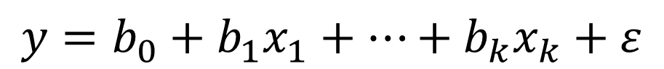
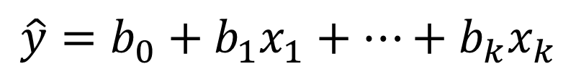
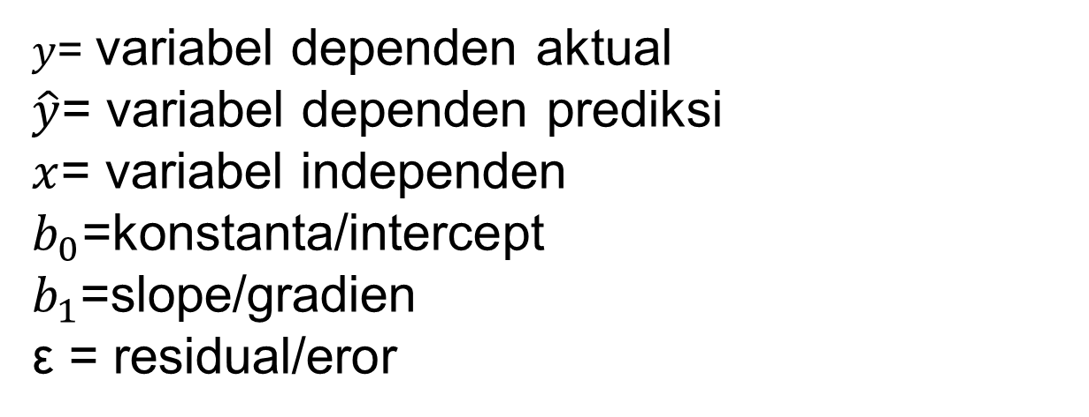
Regresi Linier Berganda
Regresi linier berganda (k variabel independen):

Slide 18
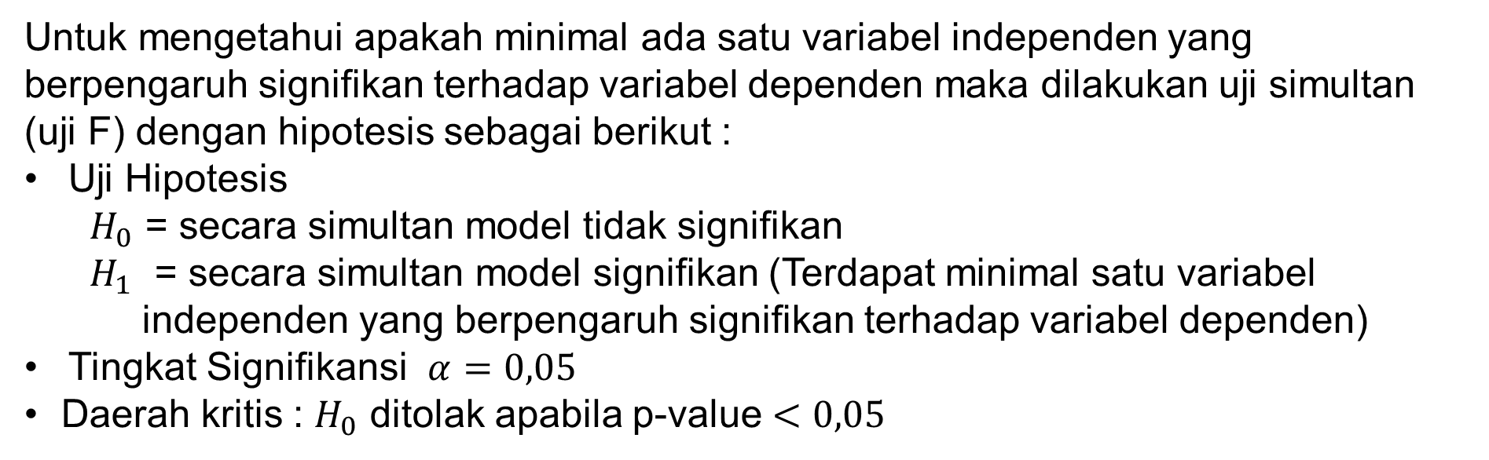
Uji Simultan (Uji F)

Slide 19
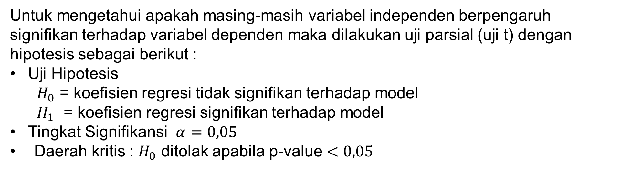
Uji Parsial (Uji t)

Slide 20
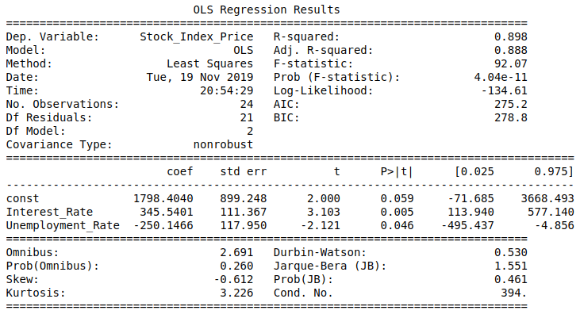
Regresi Linier di Python

Slide 21
Diagnostic Checking

Slide 22
Diagnostic Check
Residual dalam model regresi linier harus memenuhi asumsi:
Homoskedastisitas: Variansi dari residual adalah sama atau homogen.
Non autokorelasi: Residual tidak saling berkorelasi satu sama lain.
Normalitas: Residual berdistribusi normal.
Non Multikolinearitas terjadi ketika variabel independen dalam model regresi tidak saling berkorelasi

Slide 23
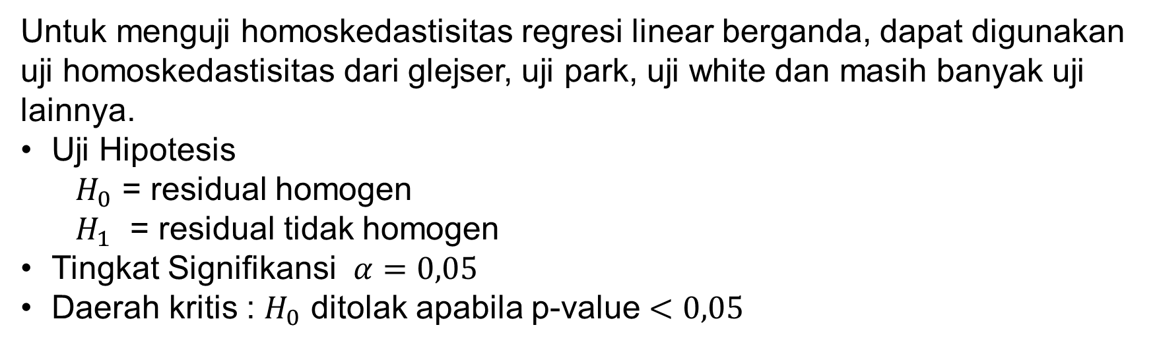
Homoskedastisitas Residual

Slide 24
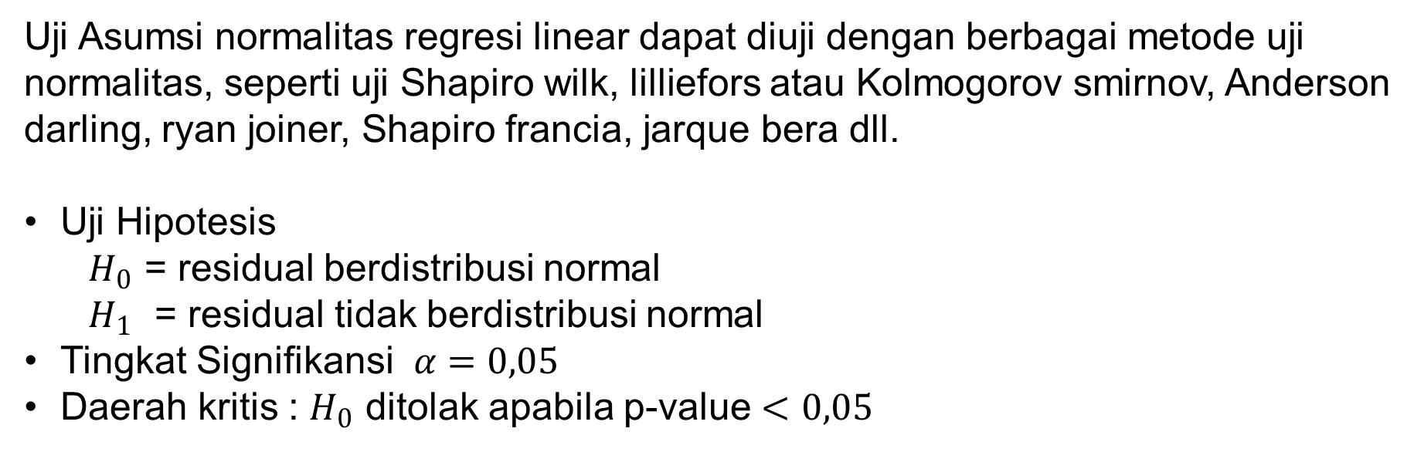
Normalitas Residual

Slide 25
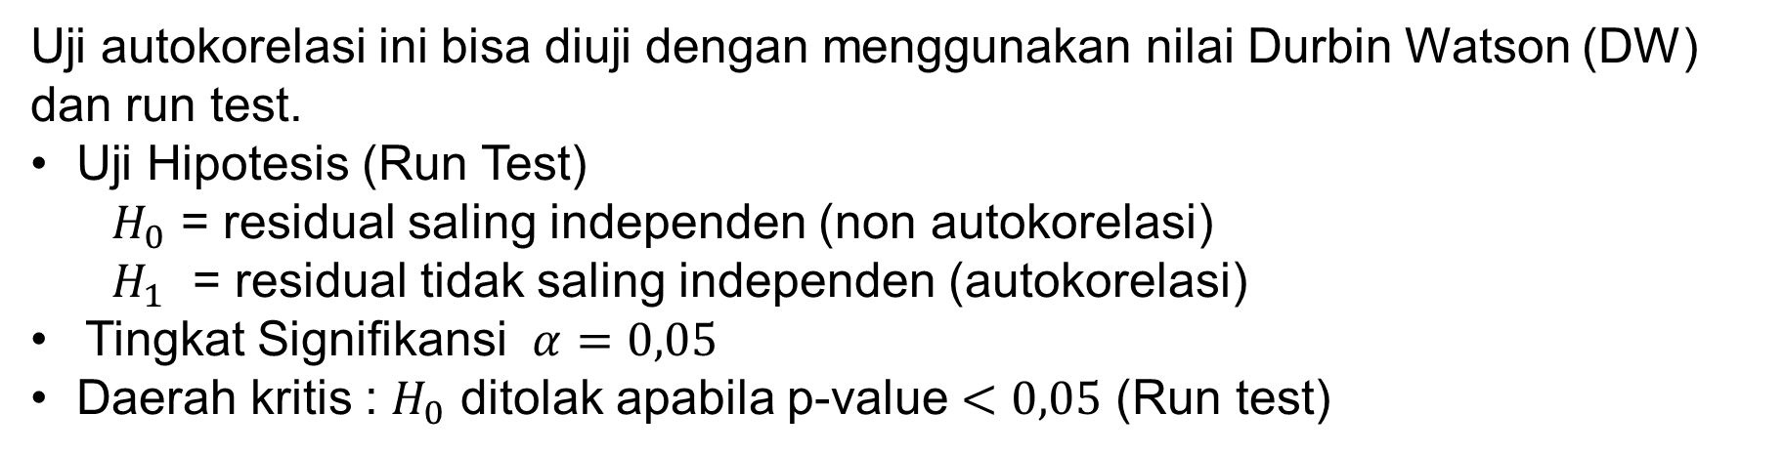
Non Autokorelasi Residual

Slide 26
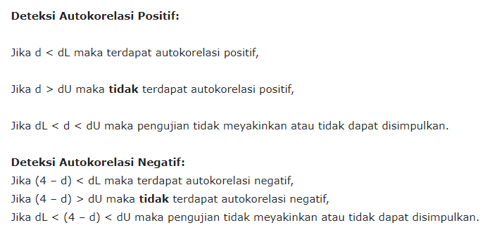
Non Autokorelasi Residual
Durbin Watson Test

Slide 27
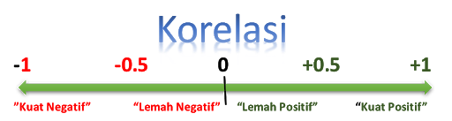
Non Multikolinearitas
Variabel independen dikatakan tidak saling berhubungan atau berkorelasi satu sama lain apabila memiliki nilai Variance Inflation Factor (VIF) kurang dari 10 dan korelasi kurang dari +-0.8.

Slide 28
Regresi Ridge

Slide 29

Bias Variance Trade-Off

Slide 30
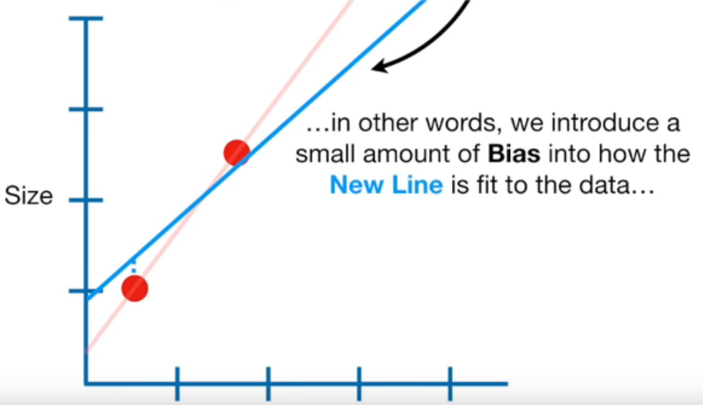
The main idea behind Ridge Regression is to find a New Line that doesn't fit the Training Data as well
Weight

Slide 31
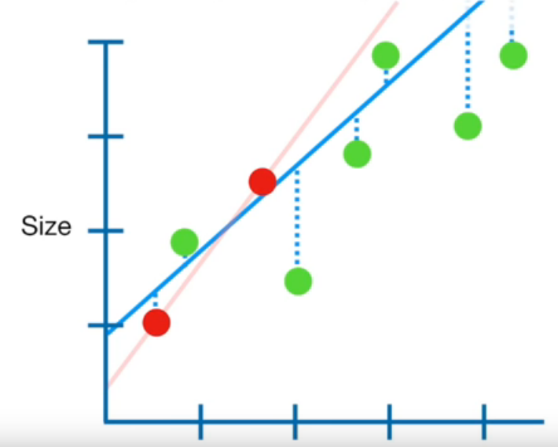
In return for a small amount of Bias, we get a significant drop in Variance for Training Data
But, by starting with a slightly worse fit in Training Data, Ridge Regression can provide better long term predictions.
Weight

Slide 32
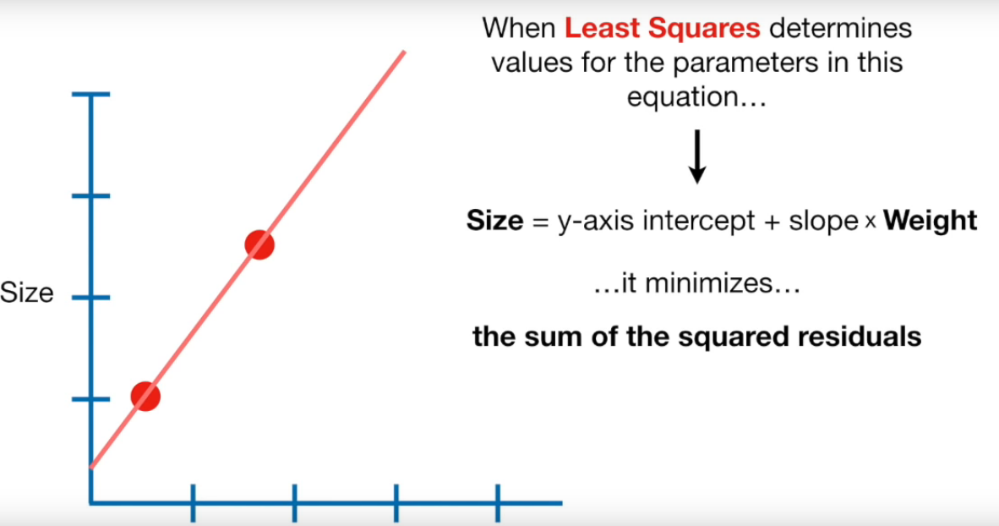
Weight

Slide 33
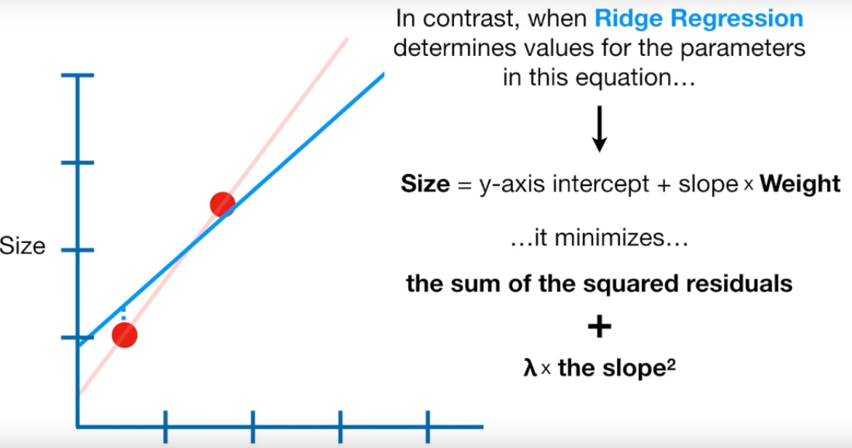
Weight
This part is to add a penalty here
This part determine how severe the penalty

Slide 34
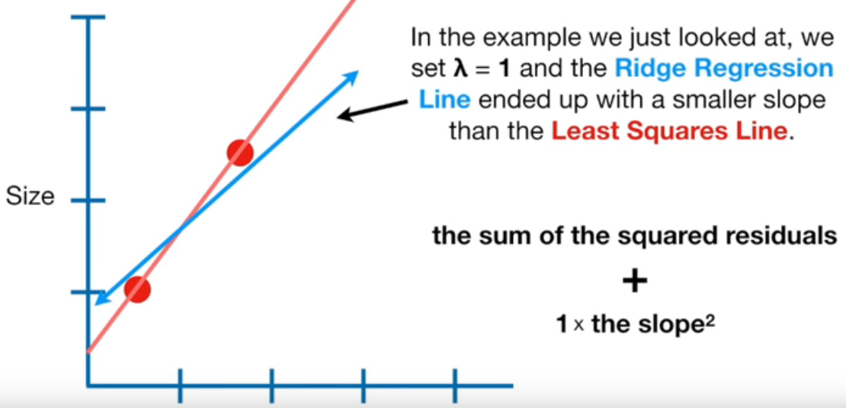
What if we increase the value of lambda?
Weight

Slide 35
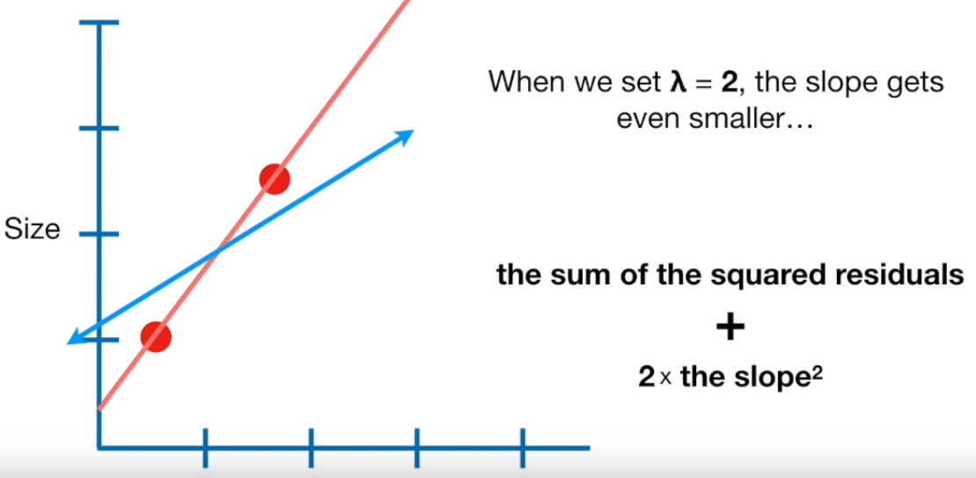
What if we increase the value of lambda?
Weight

Slide 36
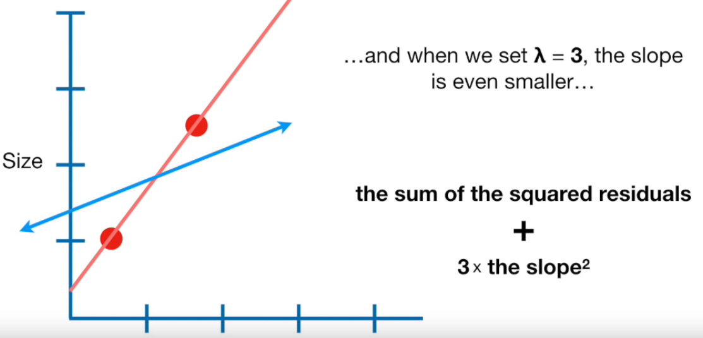
What if we increase the value of lambda?
Weight

Slide 37
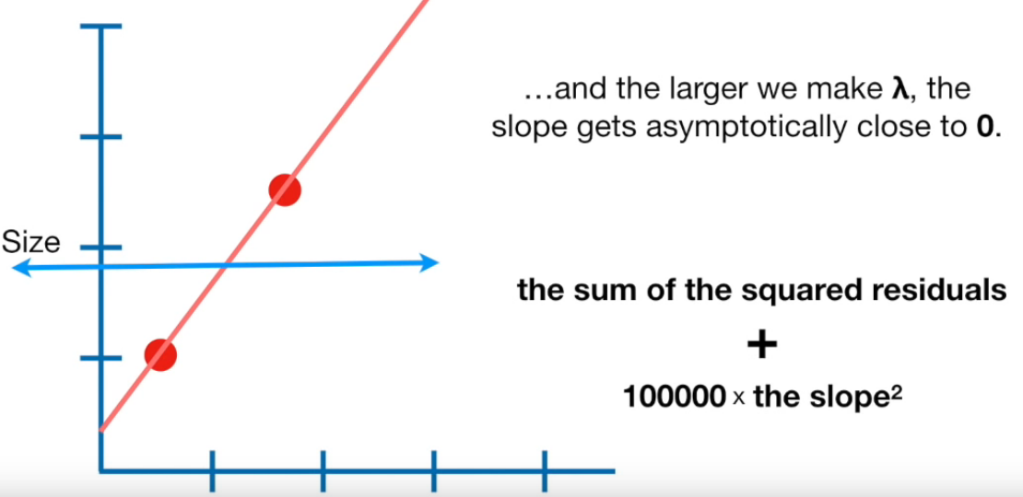
What if we increase the value of lambda?
Weight

Slide 38
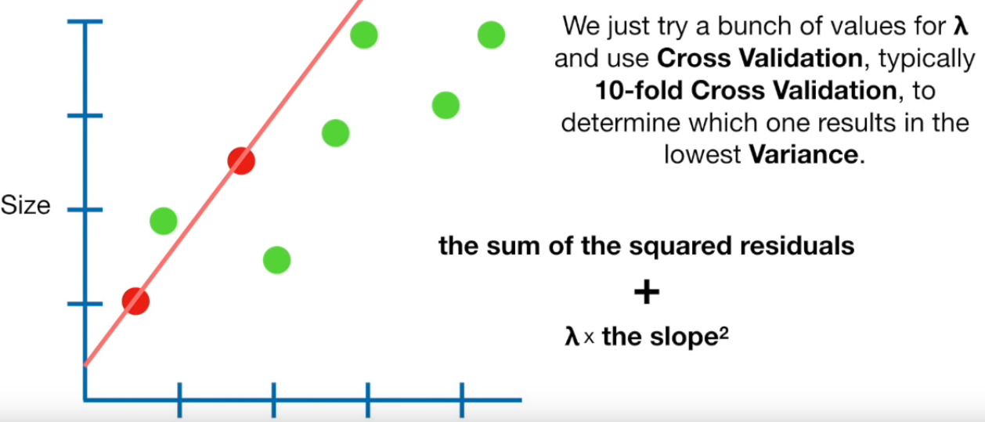
How to choose lambda then?
Weight

Slide 39
Regresi Lasso

Slide 40
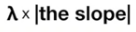
Weight
This part is to add a penalty here
This part determine how severe the penalty

Slide 41
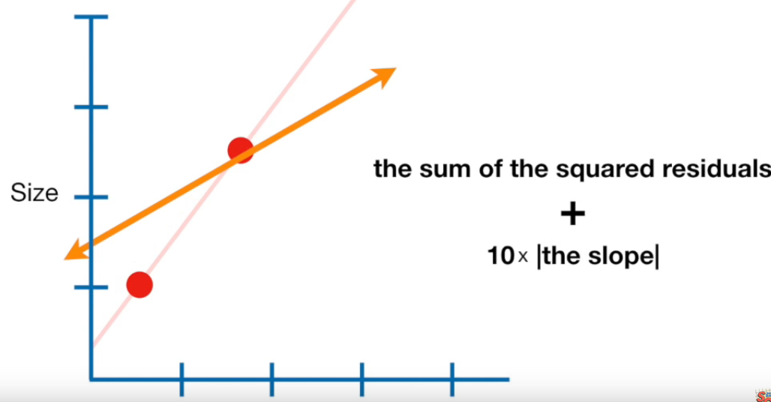
OK! Let’s try to choose our lambda value in Lasso Regression
Weight

Slide 42
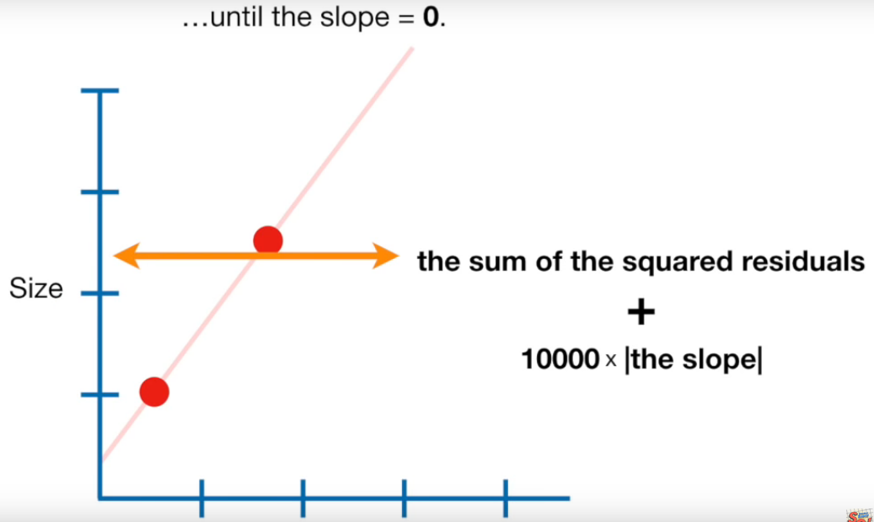
OK! Let’s try to choose our lambda value in Lasso Regression
Weight

Slide 43
Ridge Regression can only shrink slope until close to 0 (zero),
while the Lasso Regression can shrink it until 0
What the advantage?

Slide 44
Imagine we will predict size, with several variables
These variable is still make sense, right?
But, what about these?

Slide 45
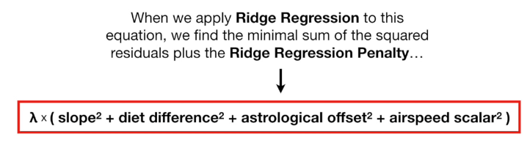
Imagine we will predict size, with several variables
When the lambda value goes up...
but these two will shink a lot, close to 0
this parameter will shrink a little bit

Slide 46
But, when we apply lasso regression...
When the lambda value goes up...
but these two will shrink a lot, until 0. and those variables go away. so we have a better predictor!
this parameter will shrink a little bit

Slide 47

Both have an advantage,
Lasso Regression -> Better performance when reduce variance that contain a lot useless variables
Ridge Regression -> Better when most variables are useful
Why not use both?
(especially when we have tons of variables)

Slide 48
Regresi Elastic Net

Slide 49
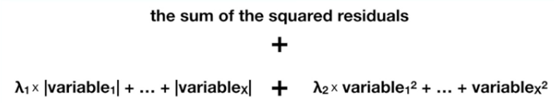
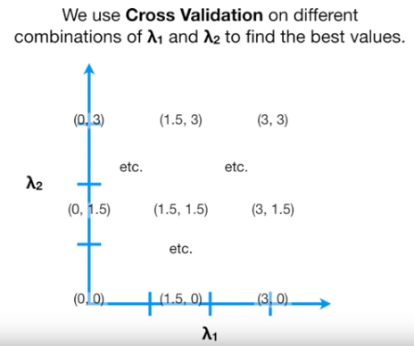
Elastic Net Regression
There are 2 lambda, for lasso and ridge

Slide 50
Evaluation Model

Slide 51
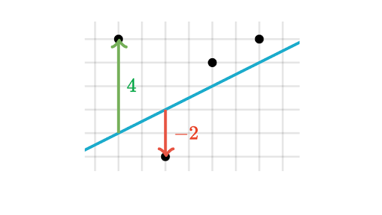
Residual

Slide 52
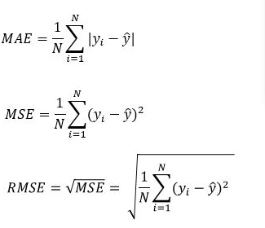
Evaluasi Model

Slide 53
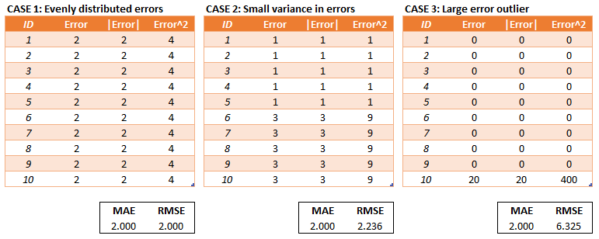
When to use them?
RMSE has the benefit of penalizing large errors more so can be more appropriate in some cases

Slide 54
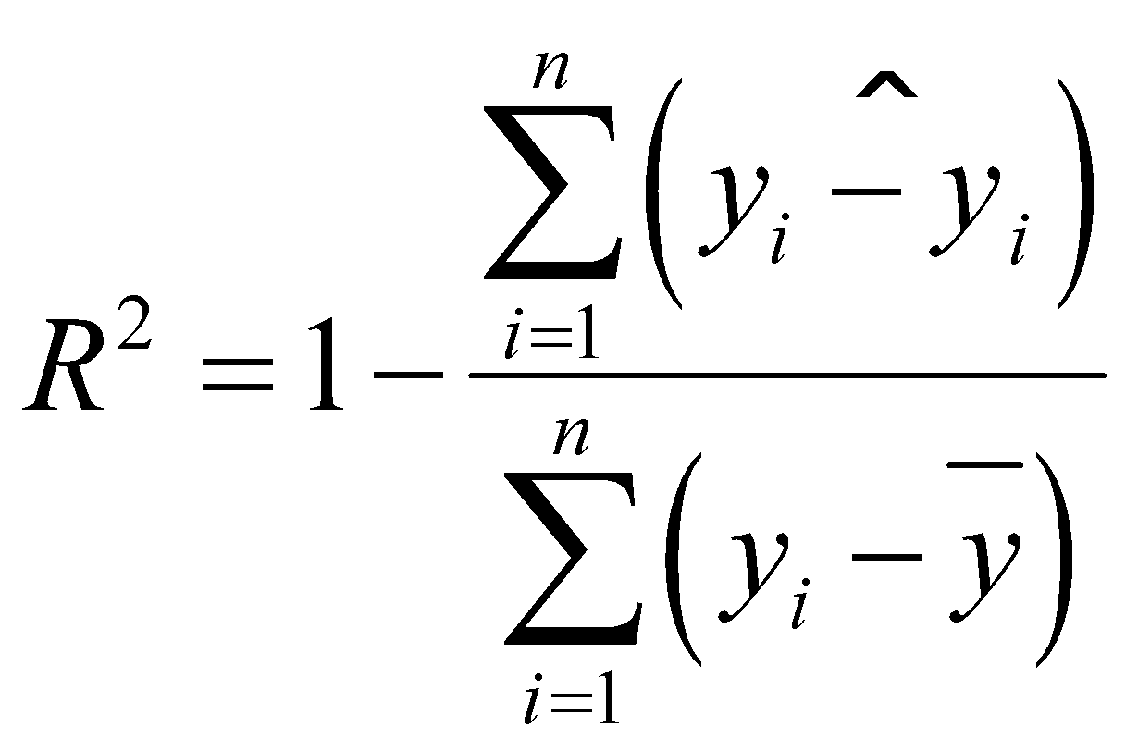
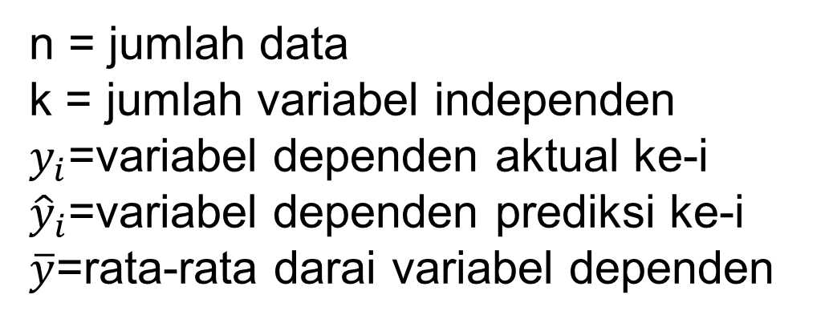
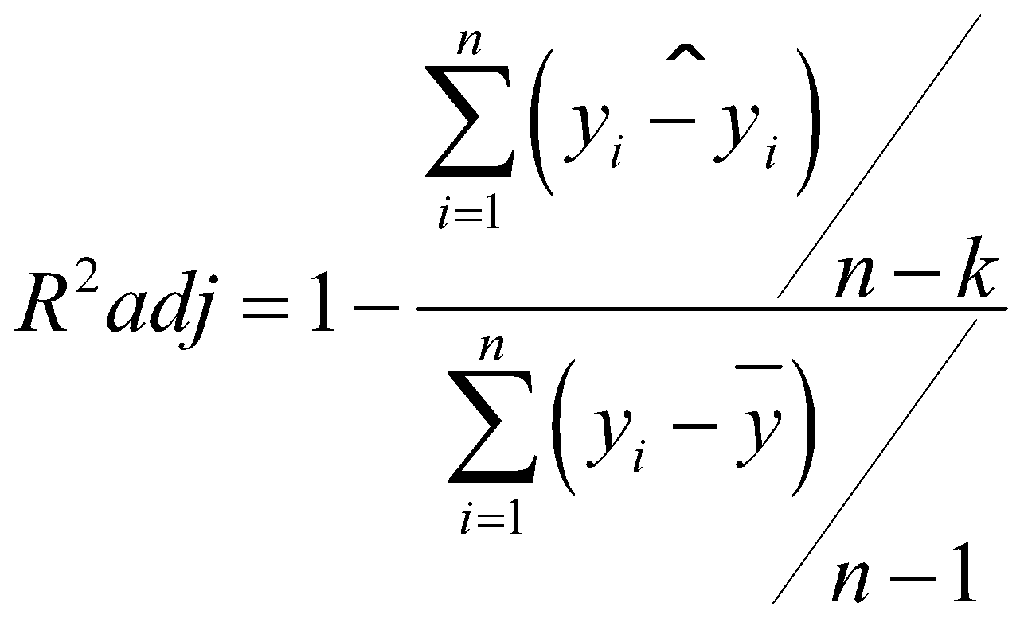
Evaluasi Model
R-Squared
Adjusted R Square

Slide 55
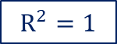
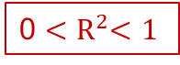
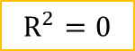

Coefficient of Determination (R²)
Y
Y
Y
X
X
X
Y
Y
Y
X
X
X

Slide 56
Thank You

